Slide 1
Exploring News: What News Matters for Stock Investors?
Emma Juettner | Prof. Muris Hadzic
Richter Program 2017

Slide 2
Introduction
How does news affect stock prices?
RavenPack Data Set
Literature Review
Descriptive Statistics
Investment Strategy
Questions

Slide 3

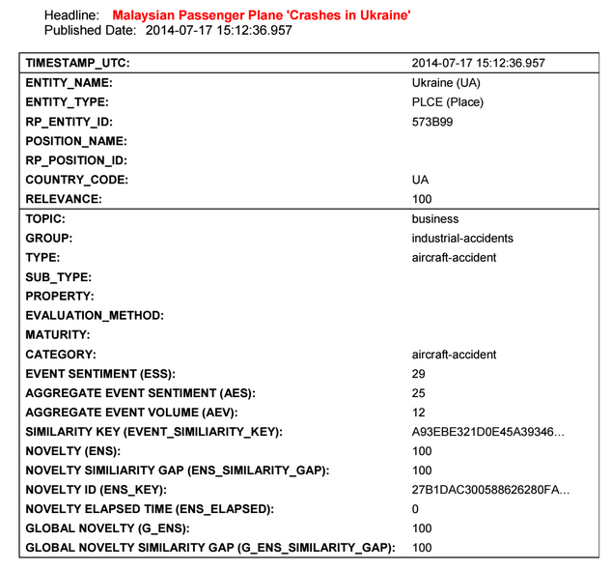
The RavenPack Data Set
News stories from 2000--2016
118,822,474 news items
Scans news sources & processes articles
Language processing algorithms
Measures news sentiment, relevance, novelty, etc.
ESS scores from 0-100

Slide 4
Literature Review
News is more often positive than negative
Most news is neutral
Market conditions
News sentiment predicts stock performance
Overreaction vs. underreaction
Duration of news’s impact
Negative vs. positive news
News sentiment improves performance of traditional models
Cahan, Jussa, & Luo (2009)

Slide 5
Literature Review
Web sources vs. news wires
News wires less positive
Overall positive bias
News event types
Forbes predicts “analyst-ratings” and “equity-actions”
Yahoo! Finance predicts “labor-issues” and “revenues”
News article types
News wires vs. web sources
Dow Jones hot-news-flashes
Hafez & Xie (2014)

Slide 6
Literature Review
Seasonality
Open & close of markets
Thursdays
More negative news on weekends
News volume peaks around quarterly earnings announcements
Positive bias for equities, negative bias for global macro news
Hafez, Guerrero-Colon, Duprey (2015)

Slide 7
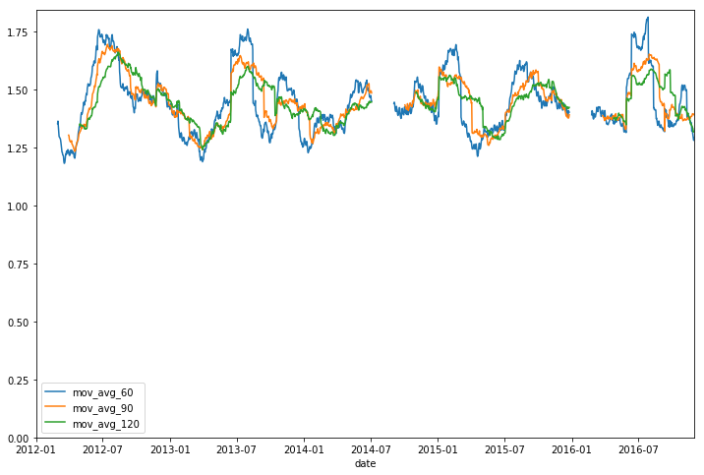
Descriptive Statistics (2012-2016)
Total Items: 32,961,688
Average Event Sentiment: 52.0444
Average Aggregate Event Sentiment: 63.7434
Average Relevance: 39.8304
Average Novelty: 91.0449

Slide 8
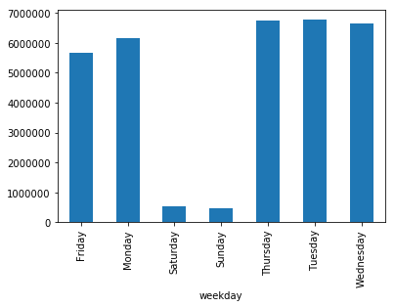
Descriptive Statistics (2012-2016)
Total Monday News: 6,144,325
Total Tuesday News: 6,775,013
Total Wednesday News: 6,643,843
Total Thursday News: 6,733,343
Total Friday News: 5,662,625
Total Saturday News: 544,387
Total Sunday News: 458,151

Slide 9
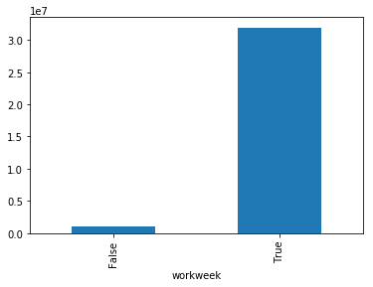
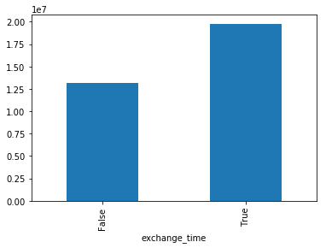
Descriptive Statistics (2012-2016)
Total Weekday News Before 3:30 pm: 19,780,467
Total Weekday News After 3:30 pm: 12,178,682
Total Weekday News: 31,959,149
Total Weekend News: 1,002,538

Slide 10
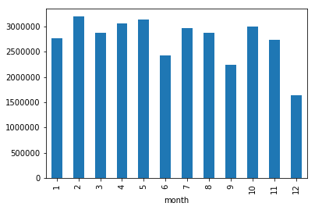
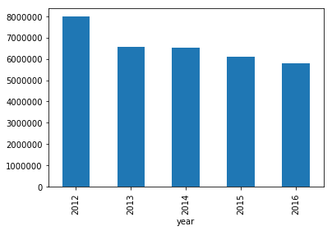
Descriptive Statistics (2012-2016)
News Volume by Year
News Volume by Month

Slide 11
Investment Strategy
Match stock data with news sentiment data
Sort stocks by average ESS for each month
Rank stocks from 1 to 4 based on ESS (lowest to highest sentiment)
Calculate average returns for rank 1 & 4 stocks
Repeat for different types of news

Slide 12
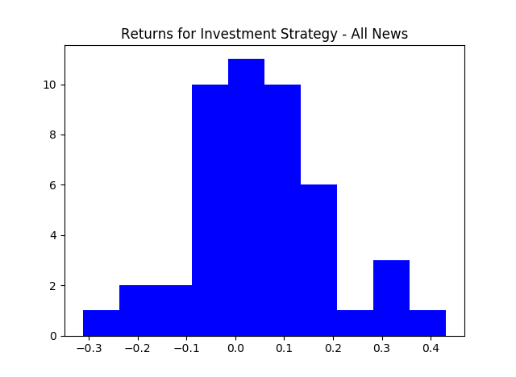
Investment Strategy
Results:
Earnings and Analyst Ratings have highest returns
Overall rate of return: 0.3972%
News Type | Average Return | Standard Deviation
Earnings | 0.7279% | 0.1415%
Analyst Ratings | 0.5159% | 0.1869%
Overall | 0.3972% | 0.0932%
Stock Prices | 0.1987% | 0.2918%
Insider Trading | 0.1617% | 0.1205%
Dividends | -0.0004% | 0.1688%
Tech Analysis | -0.2821% | 0.1003%
Acquisitions/Mergers | -0.5094% | 0.2287%
Products/Services | -0.6261% | 0.2092%

Slide 13
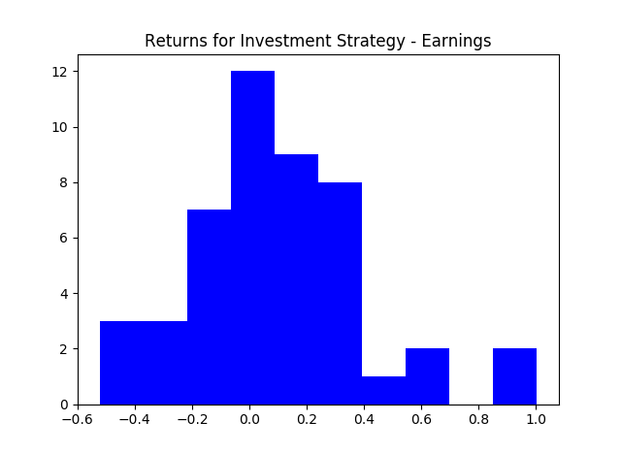
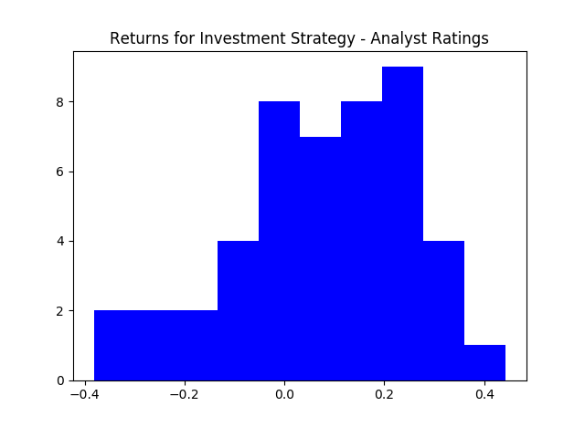
Investment Strategy

Slide 14
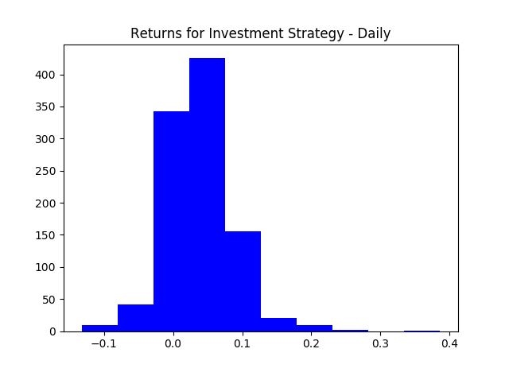
Investment Strategy
Daily Results:
Mean rate of return: 0.3102%
Standard deviation: 0.01001%

Slide 15
Future Research Possibilities
Adjusting for seasonality
Measuring market conditions’ impact on news-based predictions
Using news sentiment to predict volatility
Measuring spill-over effect between companies/organizations
Investigating investor attention
…and more

Slide 16
Questions?

